Slide 1


Bank of Baroda Hackathon - 2022
Technology Partner
Your Team Name : TROJAN
Your team bio : III CSE St.Joseph’s college of engineering
Use Case: Video Analytics
Date : 20/9/2022

Slide 2

Why did you decide to solve this Problem statement?
In the current era, monitoring every video regularly to understand the activities going inside a bank is impossible
Our system is built to reduce human assistance
To improve the accuracy as manual work may lead to human error
To collect as much data as possible which can then be used for pattern analysis

Slide 3


Business Model
User segments
ATM maintenance and security team
Bank maintenance and security team
Key Activities
Enhance the bank system by analysis the given video data
Predict future activities using the derived pattern
Improve the security system of the Bank system
Dataset focus
Here, the dataset is the recorded/live video.
This video contains various different data so the system won’t be biased.
Key Resources
Bank live feed videos
Bank recorded videos
ATM live feed videos
ATM recorded videos
Future Enhancements
Check whether the shutter is closed or not
Alert sent to the security team when no security is found outside the ATM
Check whether the machines are working properly or not
Cost Structure
Storage
Azure cognitive services and tools
Site Maintenance Engineers
Server Maintenance
Revenue Streams
Bank and ATM security systems
‹#›

Slide 4
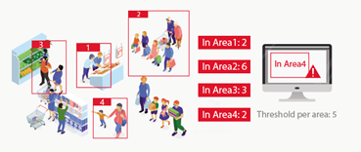
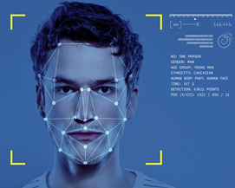
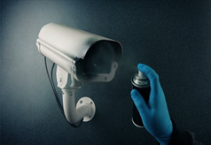
Existing model
Count of People
Face Recognition
THEM
US
Focuses on anomaly detection
Used to find unusual pattern
Enhances the security system
Feedzai’s Anomaly Detection-based Fraud Detection Platform
Ayasdi’s Anti Money-laundering Solution
Main focus on analysing the video to get meaningful data
Using the retrieved data to predict future behavior
To enhance the security system
Tampering of Camera

Slide 5
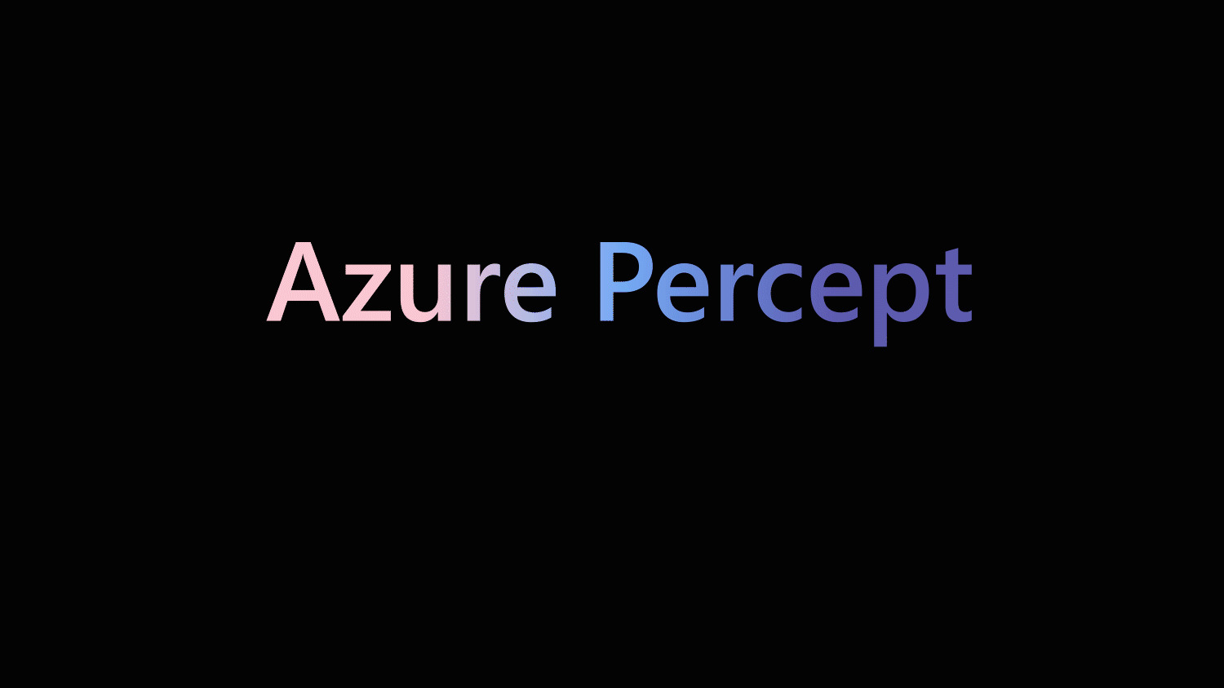

Azure tools or resources
PERCEPT VISION
FACE API
AZURE AI & ML
Can be used to get the number of people at any given time
Can be used to detect and identify faces from the database
Can be used to check for tampering of cameras

Slide 6
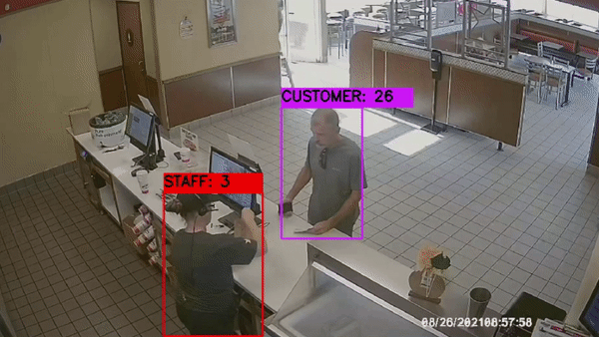
Count of people (Percept vision)
If the number of people inside the ATM exceeds 2 (or any given number), alert will be sent
Number of people visiting a counter during each hour is calculated and a graph is created. This graph can be used to provide the peak hours of each counter
From this, we’ll know which counter is at demand at which hour - hence can handle traffic
SOLUTION

Slide 7
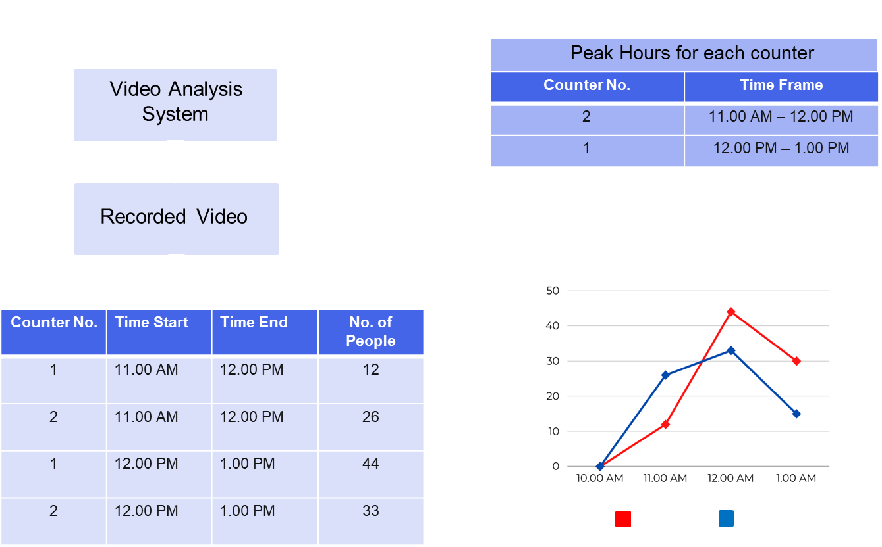
People in the Bank
Number of people
CCounter 1
CCounter 2

Slide 8


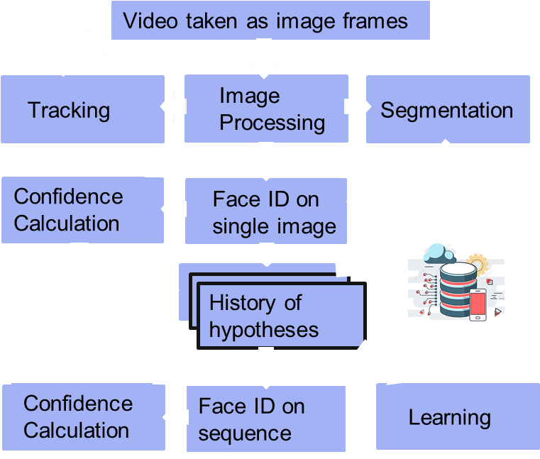
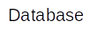
2. Face recognition
Using Azure’s FACE API, it becomes easy to identify a face
Compare the face of the employee who is sitting in the counter with the database
Check whether its the employee who is working or someone else
To detect any criminals or black listed people inside the bank - alarm will be sent to the security - security will check and forward the alarm to the police
Camera
DataBase

Slide 9
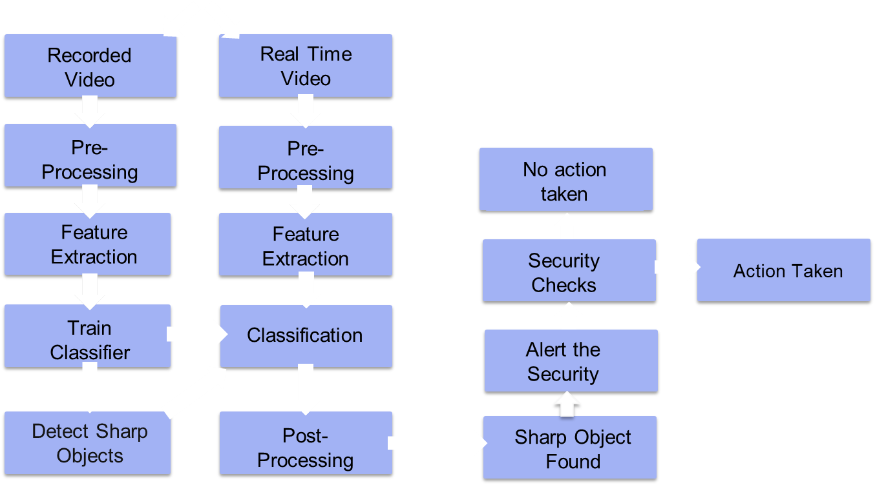
3. Tampering of Camera and Object detection
CaCamera

Slide 10
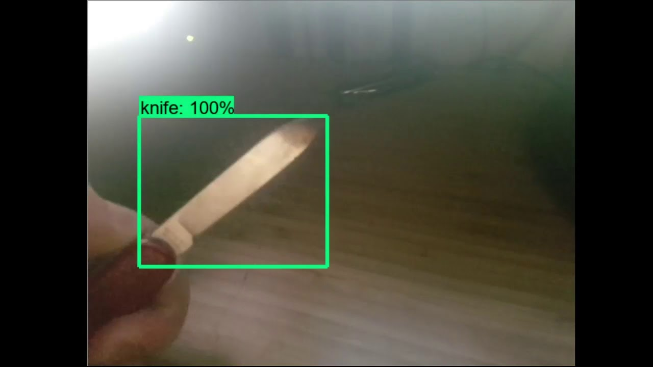
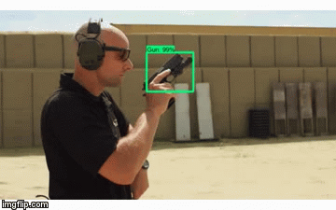
Feed sharp objects/Guns as data for training the model
System identifies these objects from training videos
It’s accuracy is calculated
Using the trained model, this system tries to find sharp objects in recorded and live videos from ATMs and Banks
When a sharp object is detected, security is alerted
Security checks the situation and if it’s of no threat, alert is ignored
If not, police force is alerted

Slide 11
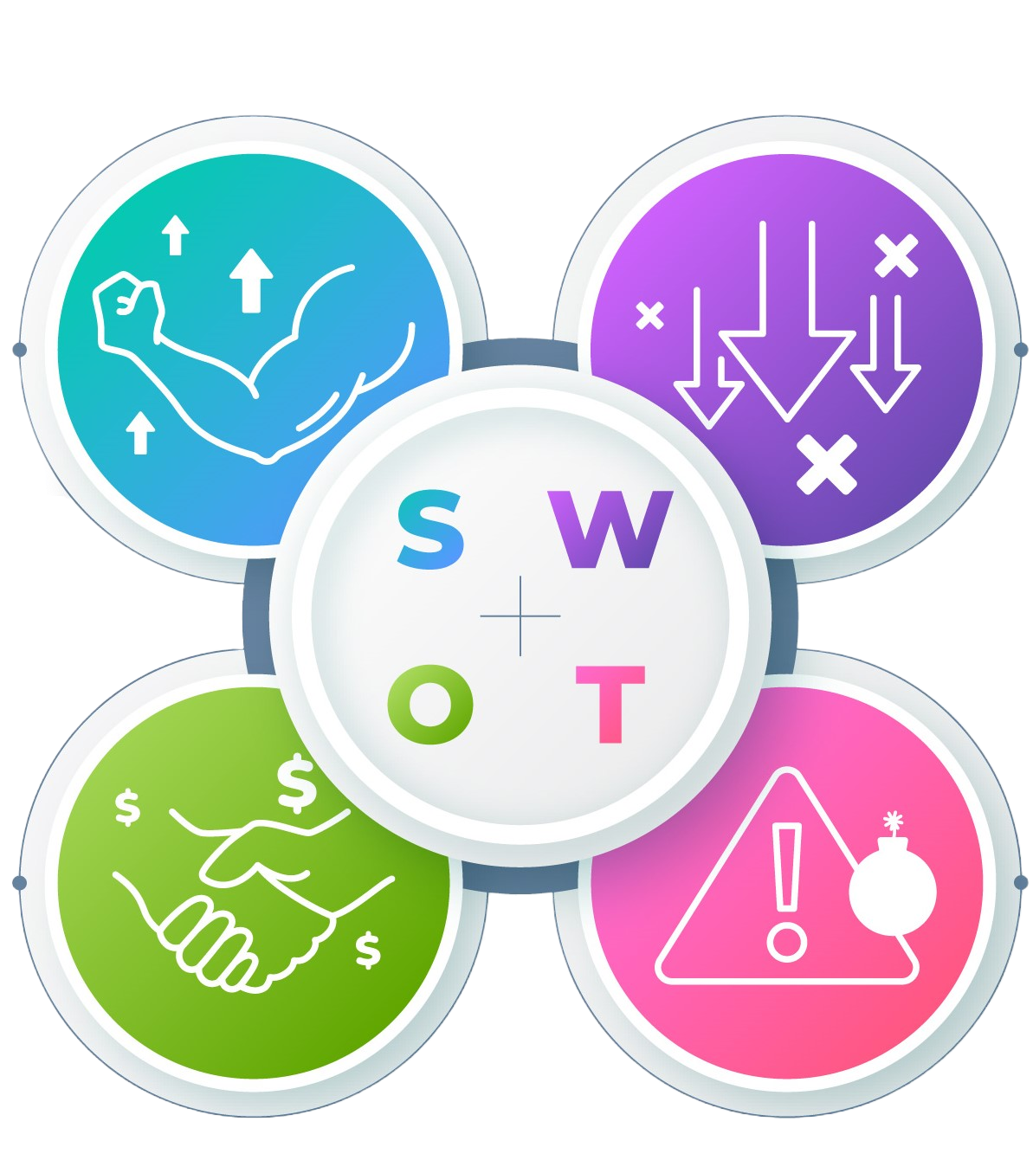
SWOT ANALYSIS
STRENGTHS
WEAKNESSES
Improves the security system
Lots of meaningful data retrieved
High accuracy, less bias
Current system doesn’t have much implementation with live feed
THREATS
OPPORTUNITIES
If the system predicts incorrectly, there will be unwanted, frequent alerts sent
With the current uprise in the AI and ML trends, there’ll be a tremendous improvement in the system
Security system will get enhanced

Slide 12
Thank you!

